Slide 1
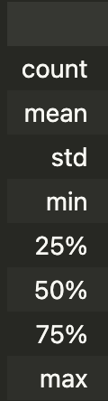
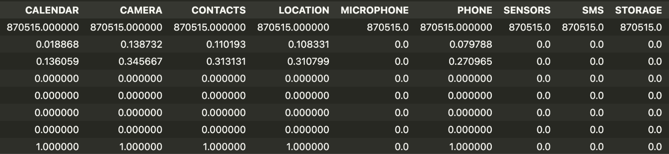
It appears that some of the permission features are all zeros (SENSORS, SMS, and STORAGE)

Slide 2
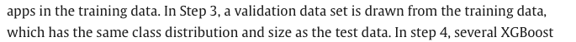
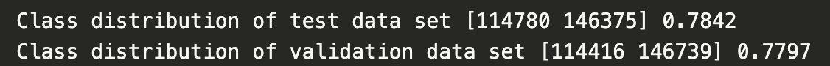
Are these distributions close enough? Or should I manually make them exactly equal?

Slide 3
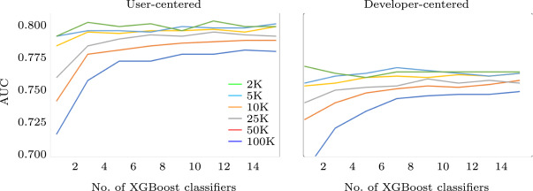
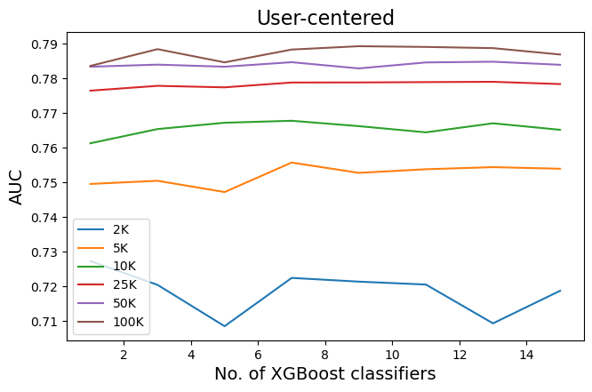
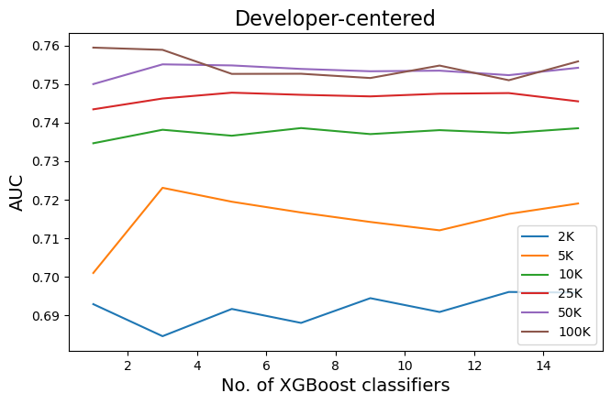
Something is off…
My best score for user-centered is with 9 classifiers instead of paper’s 11.

